Slide 1
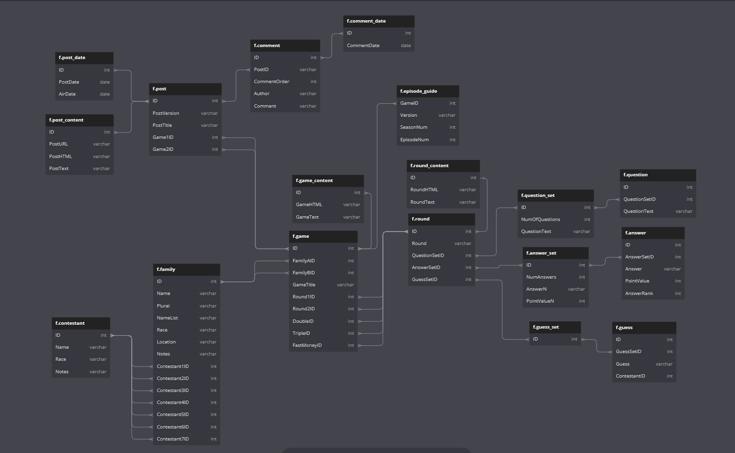
Celebrity not included
Celebrity included
Done
WIP

